Slide 1
RWIEF
RIGHT OF WAY INTERNATIONAL
EDUCATION FOUNDATION
2019 FALL FORUM

Slide 2
THANK YOU PORTLAND!

Slide 3
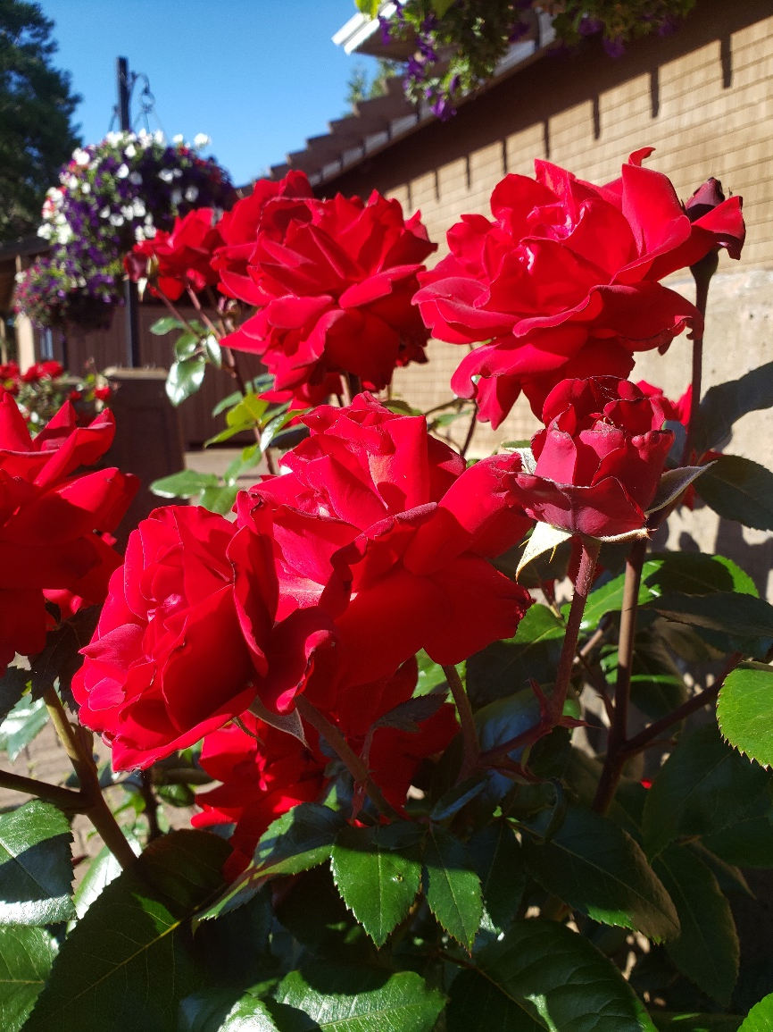
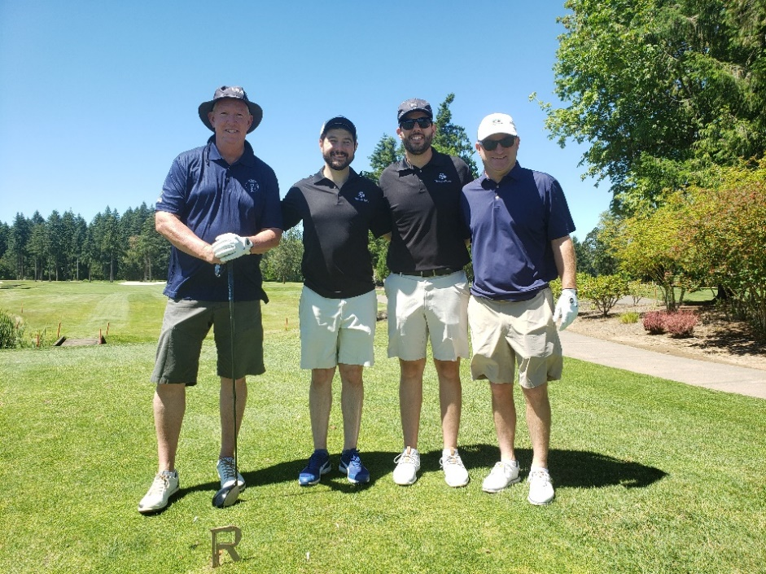
ROSE CITY CLASSIC

Slide 4
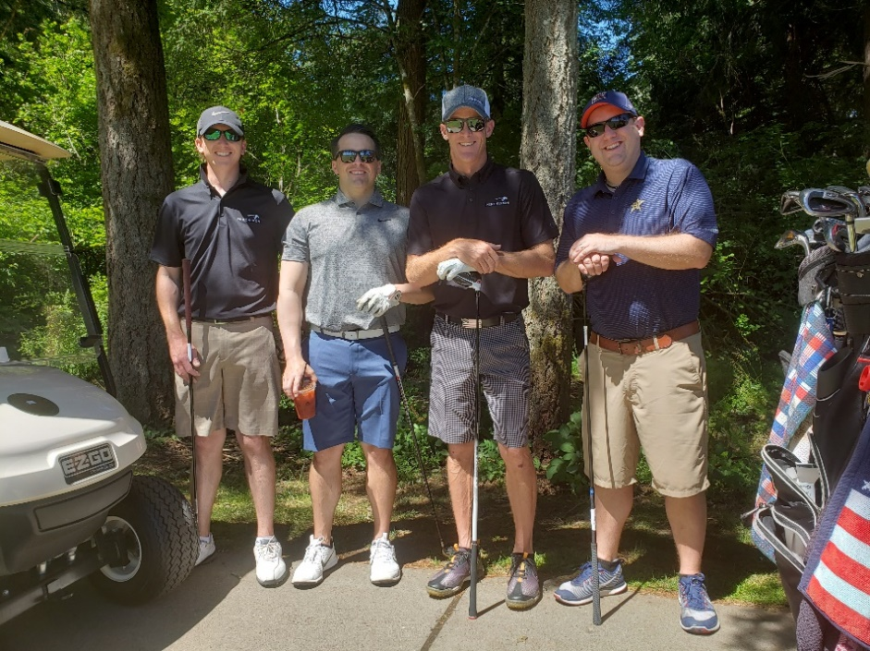
ROSE CITY CLASSIC

Slide 5
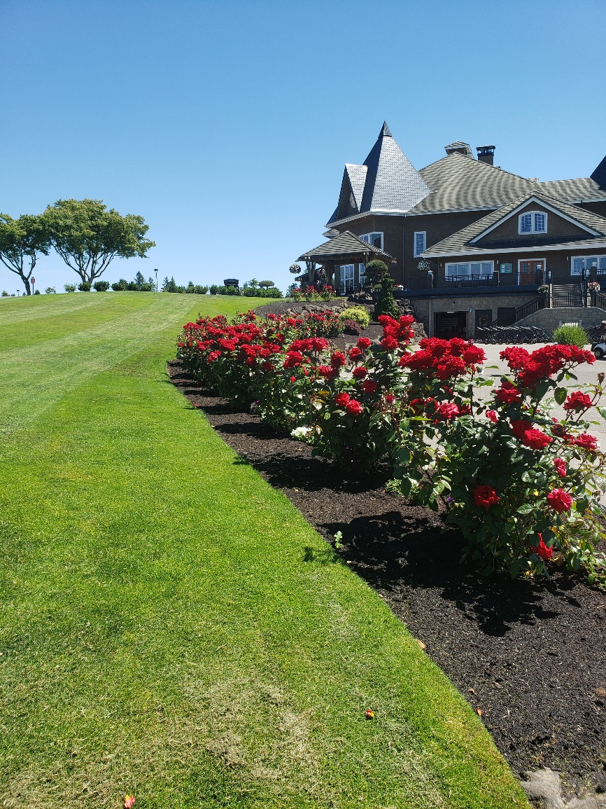
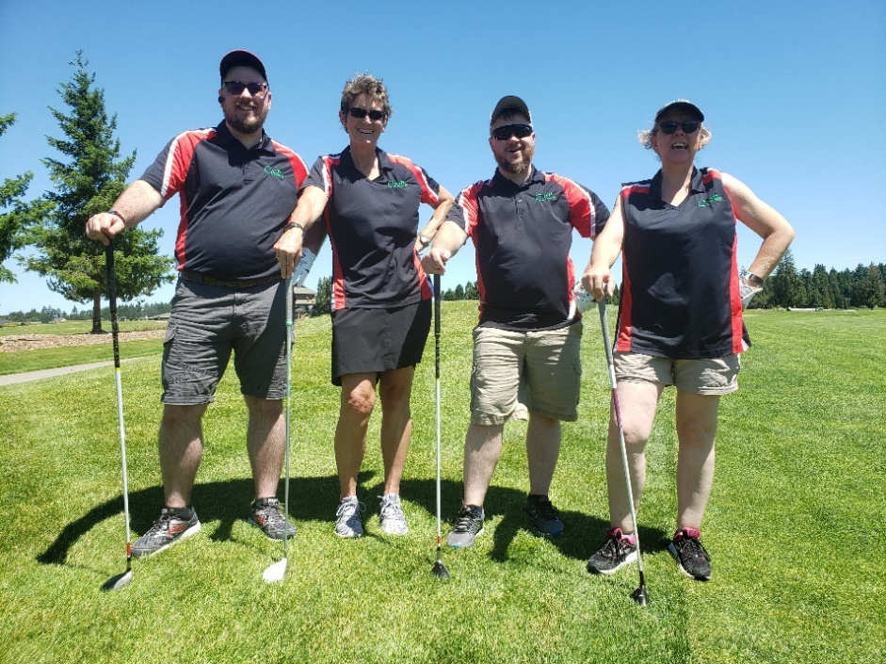
ROSE CITY CLASSIC

Slide 6
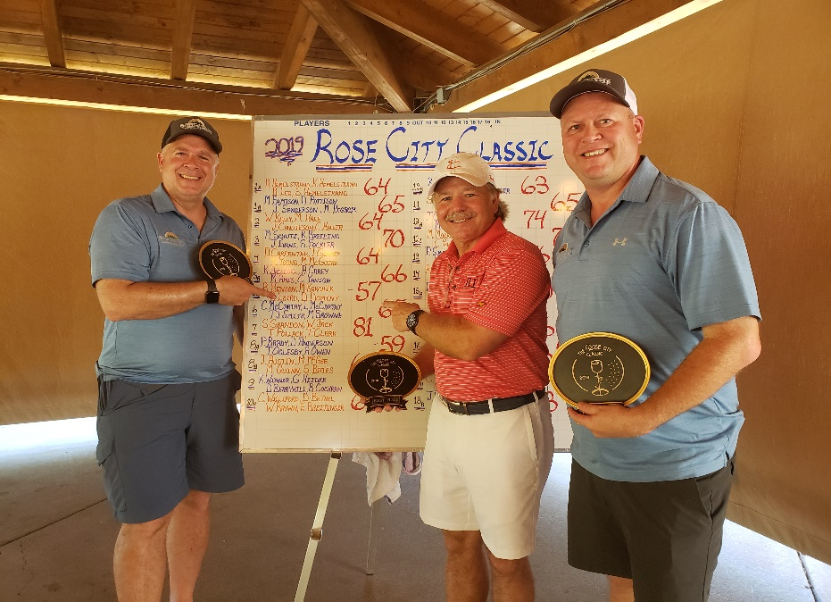
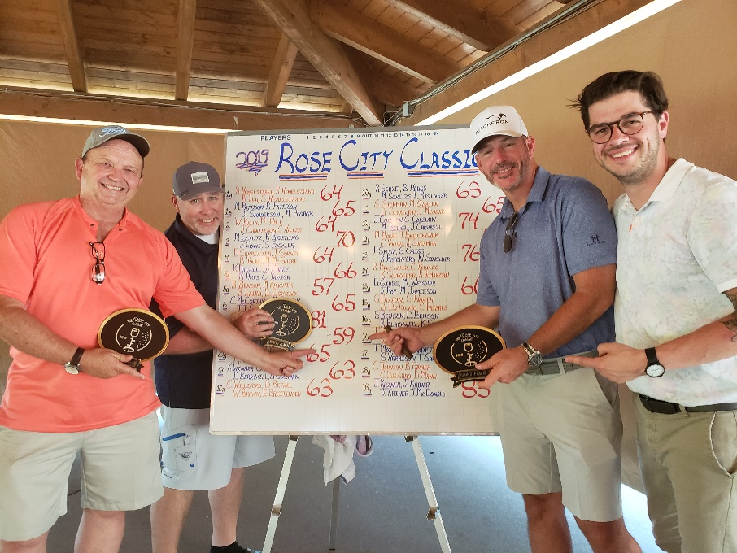
AND OUR WINNERS

Slide 7
THANKS TO GOLF SPONSORS

Slide 8
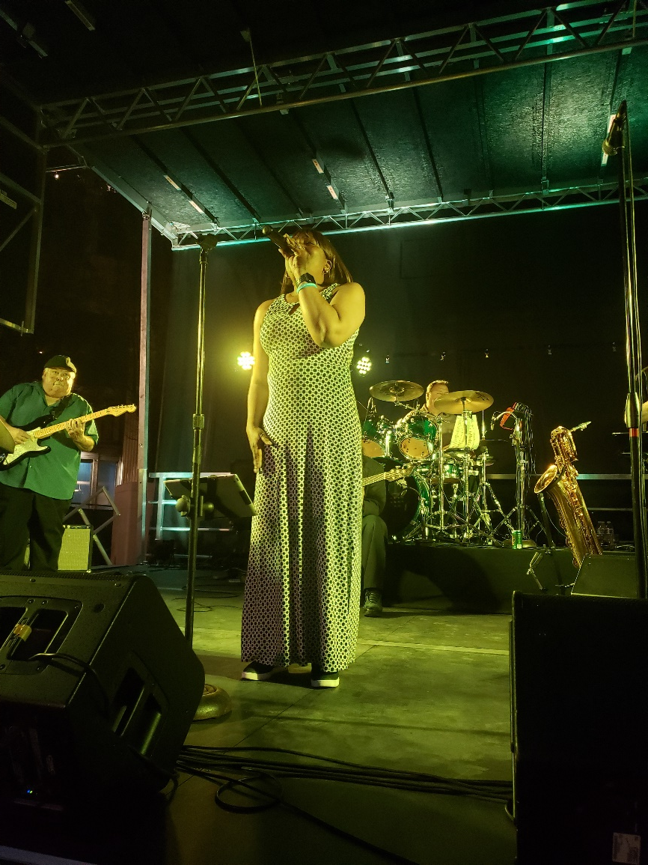
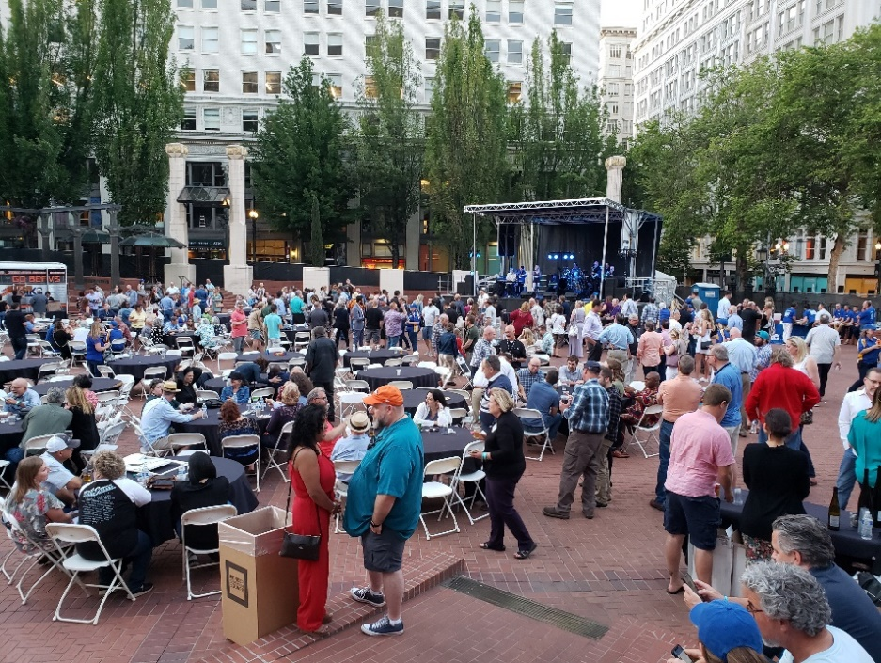
MONDAY NIGHT EVENT

Slide 9
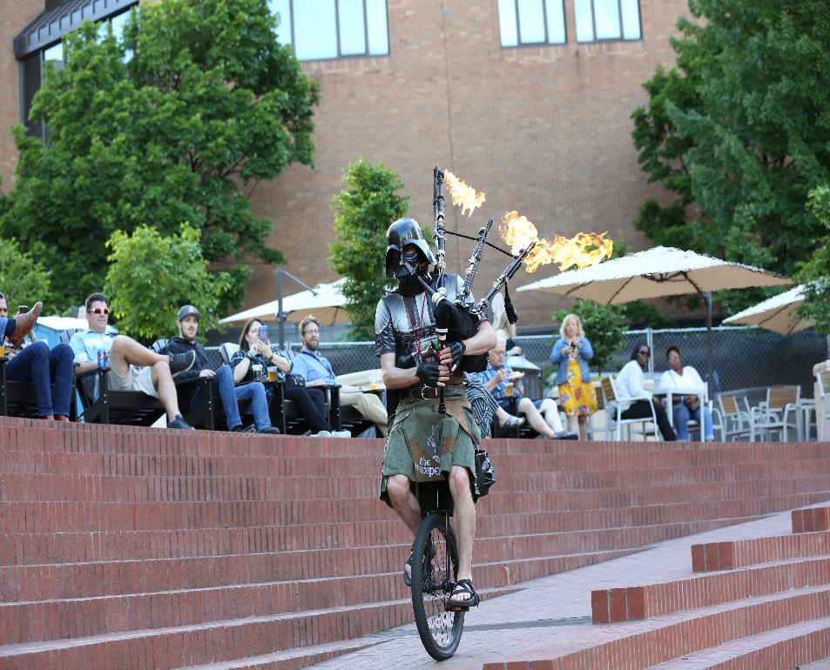
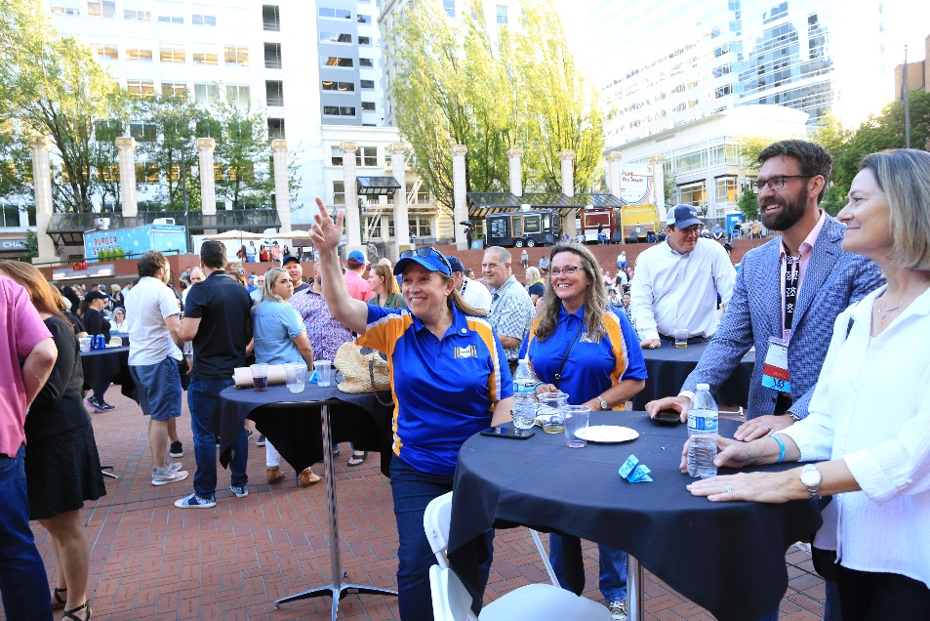
MONDAY NIGHT EVENT

Slide 10
THANKS TO MNE SPONSORS

Slide 11
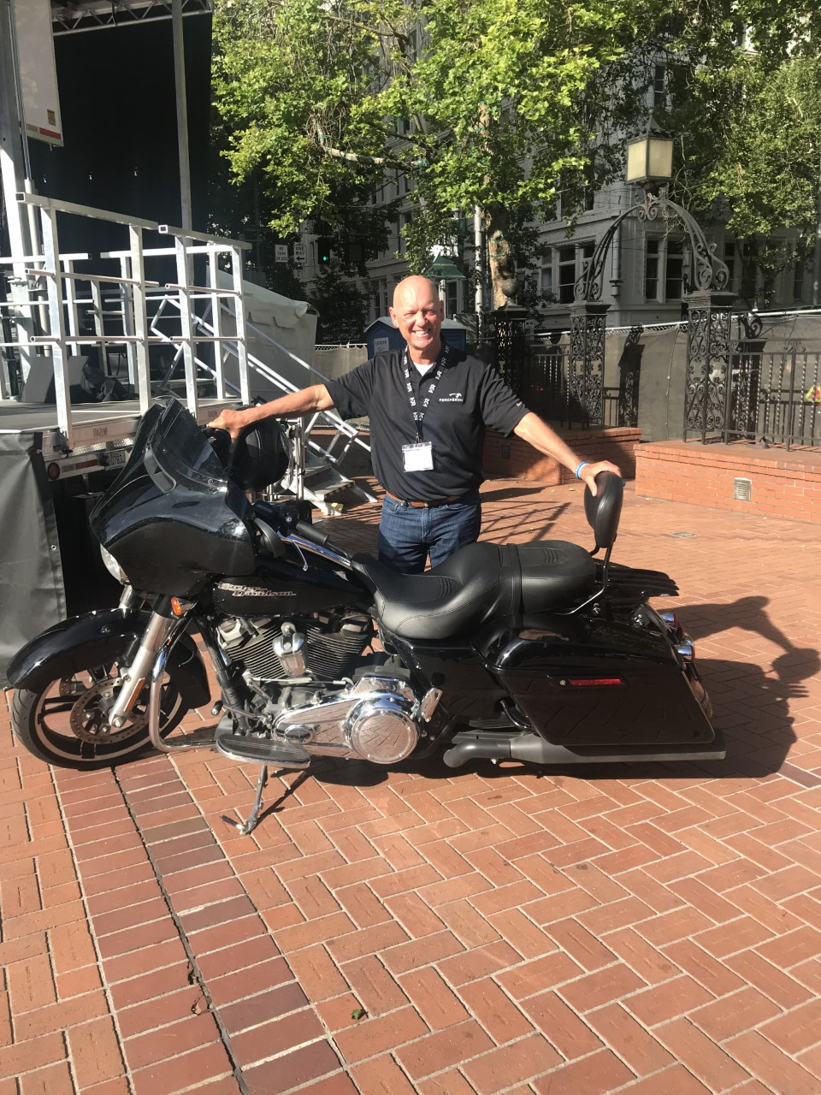
Ride For The Foundation’s FUNdraiser
Each year Steve Grandon hops on his Harley at conference close and rides to next year’s site. Conference attendees have a chance to win $1,000 guessing Steve’s trip mileage. This year’s winner is Chris Haller of Fort Worth, TX.
Thanks Steve and Hog!

Slide 12
2019 CONFERENCE BY THE NUMBERS
Over 1,200 conference attendees
Over 700 Monday Night Event attendees
108 Rose City Classic golfers
$30,000 net proceeds from MNE
$20,000 net proceeds from golf tourney
$48,900 in donations/pledges at BOD
$98,900 EDUCATION FUNDS RAISED!

Slide 13
20/20 Vision Scholarship
Following the great success of the 40 For 40 Launching Careers Scholarship, RWIEF has created a new scholarship program.
The 20/20 Vision Scholarship targets individuals pursuing their RWA and/or RWP designations.
Two recipients selected from each region.
RWIEF will fund for three years, 7/1/20 to 6/30/23,committing up to $92,500.
IRWA will manage the program. Look for application notice at irwaonline.org and in Right of Way Magazine.

Slide 14
Silent & Live Auction
Using Handbid for our silent auction, we can open bidding prior to the conference. Chapters and Regions need to decide now what item they will send for the coming auction. We need item photo and description by Spring Forum 2020.
Live auction will be held during MNE.
All items must be shipped to conference site no later than June 1, 2020.

Slide 15
Auction Flyer

Slide 16
SEE YOU IN MINNEAPOLIS! June 21-24, 2020

