Slide 1
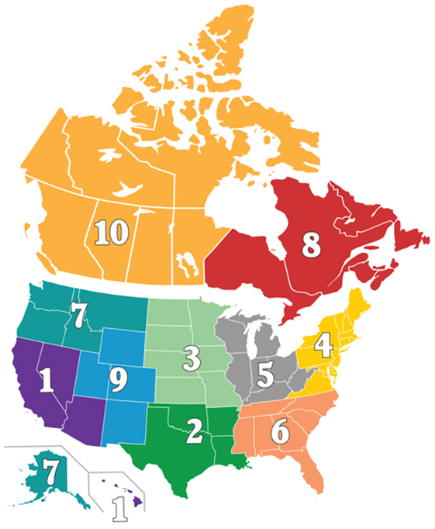
Update & Information for Chapter Leaders INEC International Elections and Nominations Committee
Region 1 2019 Fall Forum

Slide 2
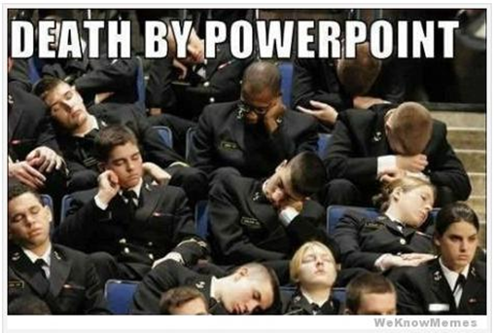
Topics 1. Chapter Election Basics
2. E-Ballots – Option for Chapter Members to vote via email
3. Upcoming call for IRWA Award nominations
4. Region Awards
Our Mission We empower professionals by elevating ethics, learning and a standard of excellence within the global infrastructure real estate community.
Has your Chapter identified its Nominations & Elections Chair?

Slide 3
Conducting a Valid Chapter Election of Officers & Voting Directors
It is vital that each chapter run a proper election of oﬃcers and voting directors each year.
Basic Steps:
Check and review Chapter bylaws for speciﬁc provisions concerning the election.
E-Ballots – we will talk more about these ……….
Build a timeline to accomplish the election tasks.
Schedule your election meeting.
Open nominations and provide a due date.
Prepare a ballot and distribute to the membership.
Hold your election meeting and follow the script!

Slide 4
Things to Remember……
Many chapters have their Chapter President/VP/President Elect also serve as a Voting Director. While this is allowable, it must be reﬂected in your Chapter’s bylaws.
For Example - DO NOT combine the Chapter President and the International Voting Director into one vote on your ballot and during your election meeting. This would be considered a violation of the International Bylaws and therefore an invalid election.
Current Chapter Oﬃcers must declare via an email or letter to your Chapter’s Nominations & Elections Chair their intention to continue service and declare for the oﬃce they intend to run.
If an individual is nominated for two positions, they must select one for which they intend to run.

Slide 5
Things to Remember……
We are all volunteers and doing our absolute best. There is nothing that could go wrong at your Chapter’s election meeting that can’t be fixed later.

Slide 6
Conducting the Election
Call the election meeting to order
Utilize the script.
Nominations can come from the floor, be sure to ask three (3) times.
If a nomination from the ﬂoor is oﬀered, the Chapter’s Nominations & Elections Chair should verify membership via the IRWA website, Membership Directory and that they meet all criteria outlined in your chapter bylaws.
Allow an opportunity for each candidate to speak for a determined period of time - say 3 to 5 minutes.

Slide 7
The Chapter Secretary is to note in the minutes of the meeting the names of those that ran for each oﬃce and the ultimate winner of the election.
Keep the paper ballots as a record of the election.

Slide 8
E-Ballots
Allowing Chapter Members to vote via email in Chapter Elections
Do you want to allow voting via email?
Pros and cons
Check your Chapter’s Bylaws to see if they are permissible first
Not in your bylaws…. Then it needs to be added….

Slide 9
E-Ballots
Updating your bylaws to allow Chapter Members to vote via email
Utilize the standard language to allow for e-ballots from IRWA HQ.
Does your Chapter use the model bylaws from IRWA HQ?
Send a draft of your proposed bylaw changes to IRWA for review and approval first– Tim Drennan & Bradly Kuhn.
Notify you Chapter Members that at the next Chapter Meeting you will be voting on bylaw changes to allow for e-ballots.
All Chapter Members get to vote on these bylaw changes. Not just your Executive Board.

Slide 10
E-Ballots
Updating your bylaws to allow Chapter Members to vote via email
Except for the office of President and for officers appointed by the President as provided in Section __ of this Article, all officers shall be elected by ballot from the active membership of this Chapter. If members are offered the opportunity to vote by electronic ballot, the electronic ballot shall be provided to all active members not less than 30 days before the date of the election. The ballot shall include (1) space for write-in votes; (2) notice that by voting via electronic ballot, the member will not be able to vote on candidates nominated from the floor, if any; (3) the name, e-mail address and mailing address of the person(s) to whom the completed ballots must be sent; and (4) a deadline by which the ballot must be received by the person(s) so designated, either electronically or by mail, which shall not be later than the day before the election. The officers so elected and appointed shall serve for one year beginning the following ________, or until their successors are duly elected or appointed and installed.
Note: some Chapters use President and Vice President others use President and President Elect.

Slide 11
Awards and Recognition
Every year at IRWA’s Annual International Education Conference, we recognize some of the industry’s finest individuals, companies, regions and chapters who have contributed to advancing the right of way profession.
International Award Categories you can submit
nominations for include:
W. Howard Armstrong Instructor of the Year
Frank C. Balfour Professional of the Year
Young Professional of the Year
SARPA - State Association of Real Property Agents Scholarship
Website of the Year
Employer of the Year
Newsletter of the Year
Chapter of the Year
Nominations for International Awards are due on February 1, 2020.
Nomination Forms can be found on the IRWA’s website, under “About Us” and then select Awards.

Slide 12
Important Dates
Deadline for International Executive Committee (IEC) Nominations is December 1, 2019.
Current leadership is:
Aimie L. Mims, SR/WA, R/W-AMC, R/W-NAC– President
Sharon N. Slauenwhite, SR/WA – President-Elect
Jacob D. Farrell, SR/WA– Vice President
James A. Olschewski, SR/WA, R/W-NAC– Treasurer
Ms. Judy Jones, SR/WA, R/W-AC, R/W-NAC– Secretary
Elected by your International Delegates at Annual Conference
Bradford Kuhn, Esq. – General Counsel
Daniel Stekol– Interim CEO
International Governing Council (IGC) is the IEC members plus our Regional Chairs

Slide 13
Important Dates
May 1, 2020 is the deadline for International Voting Director’s submissions. Chapters need to have their information submitted by this date and correct for voting at the Board of Director’s meeting.
Think about how this will fit in with your Chapter’s election meeting date?????
The Region Chair and Region Vice Chair positions are nominations and not elections.
Nominated at Spring Forum.
Elected at the Annual Conference.
Region Secretary is elected at our Forum.
A call for Region 1 Award Nominations will go out early 2020.
IRWA Annual International Education Conference​​ is coming up
June 21-24th in Minneapolis!

Slide 14
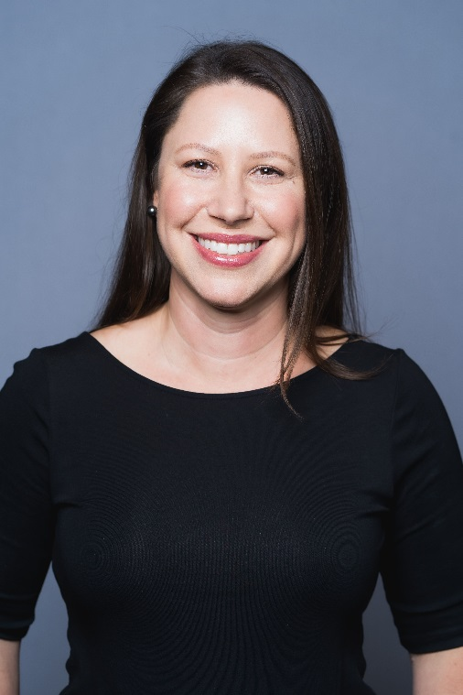
Thank you
Please reach out to me, your Region 1 International Nominations & Elections Committee representative.
Alesia Strauch – SR/WA, R/W-RAC
Office phone at AR/WS is (925) 691-8500 or
via email to astrauch@arws.com

