Slide 1


Slide 2
Field Operations Update
4Rs of Membership (Recruitment, Retention, Renewals, Reinstatement)
  PLS, New Member Campaign, Renewal Process
Membership Revenue Model (pathway scheduling)
Forming a New Chapter
Annual vs Event Sponsorships
Projects & Dates

Slide 3
Field Operation’s 4 Rs of Membership:
Recruitment:
Support chapter’s local opportunities
  (Chapter 13 - American Society of Civil Engineers conference)
Emails to non-IRWA members who participate in IRWA courses.
  2019 we’ve had 745 non-members take a classroom course
  Do you know you could save on your next IRWA class?
  1day savings $65 2day $105 3 day $145
Outreach to organizations with potential membership opportunities (PLS)
New Member Acquisition Campaign
Notes:
2019 = 745

Slide 4

Field Operation’s 4 Rs of Membership:
Recruitment:
Mission: Training Landmen Professionals
20 courses/workshops.
$200 - $2500 tuition.
Notes:
Oct 2018 – Discussions started about a possible partnership with PLS.
Aug 2019 –
PLS completed curriculum catalogue In Aug.
PLS is working with technical schools in Oklahoma to have PLS courses added to schools curriculum.
PLS would like to have IRWA student membership dues automatically covered in the tuition. PLS to pay IRWA the dues out of students tuition. Student Membership

Slide 5
Member Acquisition Campaign
Recruitment
Participating Chapters:
C3 C12 C4 C20 C38 C36 C48
C74 C10 C37 C6 C49 C79
Notes:
New Pilot in October. Originally for April.
April is first month pro-rated dues
After drop. Another way to get dropped members
13 chapters @ $300 per = $3900

Slide 6
Field Operation’s 4 Rs of Membership:
Retention:
Strong customer service focus
  Immediate: Got It! On It! Stand By!
  Thorough: Answer with the background.
  Follow Up: Anything else we can do for you?
Renewal:
IRWA Membership team and Field Operations have developed a process that works.
Renewal Process:
Train Membership Chairs of the process.
Series of emails for chapters to use. In addition to HQ emails.
Monitor and share chapter renewal status.
Notes:
Day one membership
Started a staff training exercise with a focus on Customer Service.
Goal:
Respond before the end of day to all inquiries.
Cross-training which allows staff to answer questions outside their department without transferring.

Slide 7
Field Operation’s 4 Rs of Membership:
Reinstatement:
We want you back campaign.
  Starts in April
  Reinstates 100 - 150 dropped members. (approx. $28K in recovered dues).
  Learn why members left.

Slide 8

Pathway Scheduling and Membership Revenue Model Pilot - Recap
Approach:
HQ hold courses.
C43 focus on membership
HQ incentivize C43 for Membership
Results:
HQ held 3 RWA courses NET $1,322.85
C43 membership incentives $2,380.00
Total loss for HQ $1,057.15
Takeaways:
If C43 holds courses ppl will come
Scheduling the RWA pathway can work
Notes:
Presented 7 chapters (43, 35, 15, 42, 44, 50, 63). IGC approved.
Two chapters approved (43 & 15) Three chapters were approached.
Based on course participation over 3 years. Membership, renewal percentage.
Outcome. C15 – never happened. Numerous attempts to work with chapter.
C43. – show flyer. 3 courses held.
C44 – holding a lot.
Others increased their efforts after HQ presented this option.
C100 on 10/5-10/6 = $2,595.00 Expense $1,697.70 – NET $897.30 (8ppl)
C102 on 11/9 = $1,920.00 Expense $1,239.25 – NET $680.75 (8ppl)
C213 on 11/10 = $1,590.00 Expense $1,845.20 – LOSS $255.20 (7ppl)
C200 on 1/11-1/12 (cancelled)
Total NET = $1322.85
New Member = 12 @ $50 = $600
Renewed = 89 @ $1,780.00
Total Payment to Chapter = $2,380.00
HQ LOSS = ($2,380.00 - $1,322.85) = $1,057.15

Slide 9
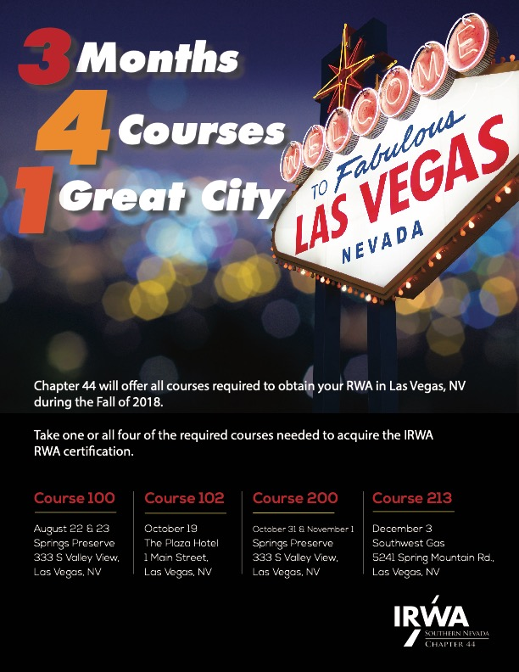

RWA Approach
SR/WA Approach

Slide 10
RWA Pathway Approach

Slide 11
New Chapter Efforts
Pittsburgh ROW Group
pitrowgroup.org
Forming a Chapter Process:
  Minimum of four meetings over 12-18 months
  Roster of each meeting held – unique attendees
  Field Operations Training
    Chapter structure & Bylaws
    Chapter elections or officers
    Chapter committees
    Membership/Education/PDC chairs role
    Fiduciary Responsibilities
    Chapter Financials: Treasurer & QB
    Course Scheduling
  Form a potential board
  Present to IEC for conditional status
  25 potential members in addition to board
  Present to IEC for official chapter status
24 months (Sept 2017)
32 events held
14 attendees avg.
7 IRWA members on avg.
Notes:
Process for Forming a New IRWA Chapter
Hold a minimum of 4 meetings, lunch and learns or seminars over a 12 – 18 month period on a variety of Right of Ways topics.
Create and keep an attendee roster for each meeting held with the topic presented as well as the presenter/facilitator. Focus will be on the unique number of attendees to each meeting, example; Each meeting held is not the same 15 people attending. Should show a diversity of attendees based on the meeting topic as well as a sufficient number of unique attendees.
If there is interest in forming a chapter after these meeting are held, the individuals interested in forming the chapter are to meet with the field operations staff who will explain in detail the expectations, requirements and responsibilities of the chapter officers to ensure a viable and sustainable chapter can succeed. This includes but is not limited to:
Chapter bylaws
Chapter election of officers
Fiduciary responsibilities
Chapter financials; Quickbooks, bank accounts, filing of taxes, reports etc
Chapter committee chairs for Education, Professional Development, Membership, Nominations and Elections
Roles and responsibilities of chapter officers and committee chairs
IRWA Courses; how to complete a breakeven spreadsheet for a course, select instructors, complete a Course Scheduling Marketing Agreement (CSMA), obtaining state accreditation (when applicable), successfully market and promote a course, course pricing
Membership acquisition, membership renewal and retention, chapter review and approval of pending members
Professional Development, explaining the Credentialing Concierge to assist members in identifying a path to credentialing
Upon understanding the requirements to support the running of a chapter as volunteers, a request to form a chapter can be submitted to the International Executive Committee (IEC) for conditional approval. The IEC will review the request; speak with field operations staff, and likely the individuals making the request to ascertain the sincerity and understanding of the particulars in volunteering to form a chapter.
Upon receipt of the conditional approval from the IEC, a minimum of 25 members and 4 officers for a total of 29 conditional chapter members must be secured to move from conditional to chapter status;
A minimum of 29 completed applications with payment of International Dues plus chapter dues (if applicable) included, via credit card or check.
6. Once steps 1-5 have been completed, the IEC can approve a charter to form a chapter with the assignment of a chapter number that is ultimately ratified by the Board of Directors at the Annual Board Meeting held in June of each year.

Slide 12
Chapter Annual Sponsorships vs Events Sponsorships

Slide 13
Chapter Annual Sponsorships vs Events Sponsorships

Slide 14
Chapter Annual Sponsorships vs Events Sponsorships

Slide 15
Projects :
Member ID added to Member Profile page
Access to your last 20 invoices on Member Profile page
Choose Digital or Print ROW Magazine
New registration link on bottom of each course page
Removal of Chapter officer contact info from website (decrease spam)
Website’s Education tab fixed
Dates:
President & Treasurer Training Call – October 2, 2019 at 11am Central
Membership & Education Chair Call – October 3, 2019 at 11am Central
Notes:
Paperless Meetings
Officer Training Calls for Sept/Oct
Sponsorship Annually
Course Backstop
Course Education Surveys
Chapter Election Process
Chapter sussession planning
Breakeven spreadsheets
Fundraising
Special events. Symposiums. Joint Forums
Development of Marketing pieces.
Bylaw Reviews

Slide 16
Questions?

Slide 17
Chapter Incentive Program
Growth, Renewal, Compliance goals stay the same.
Growth (5% & 10%):
$19,700.00
13 chapters
Compliance Uploads:
$ 9,075.00
69 chapters
Renewals (90% +):
$12,000.00
23 chapters
Hold a classroom course with an online version, receive revenue from online participants.
Online & Classroom ($150/per):
$43,500.00
290 participants (36 chapters)
Chapter receives payment for any online course participant.
Online ($10/per):
$26,790.00
2,679 participants
Increase classroom participant count by 10%+. Educ Chair receives $500 for Fall Forum attendance.
Education Chair* ($500/per):
*Membership Chair or Chapter Officer
$5,000.00
10 chapters
Total:
$116,065.00

