Slide 1
IRWA Region 1 Fall Forum 2019
Santa Barbara, CA
October 12, 2019

Slide 2
Why IRWA? We improve people’s quality of life through infrastructure development
Networking
Develop knowledge base
Professional service
Obtain Certifications

Slide 3
Certifications:
100
200 or 201
213
102 or 103 or 104
205 or 203
215 or 218 or 105
400
600
700, 501 or 502
800
900
421
603, 225 or 219
604
802
902 or 901

Slide 4
Course Scheduling For Non-Education Chairs
Make the Decision!!
Select a Course
Find a Facility
Hire an Instructor
Submit CSMA
Advertise!!
Book Order
Review Invoices
How to Schedule a Class

Slide 5
Whose Decision is it anyway?
Education Chair
Chapter Board

Slide 6
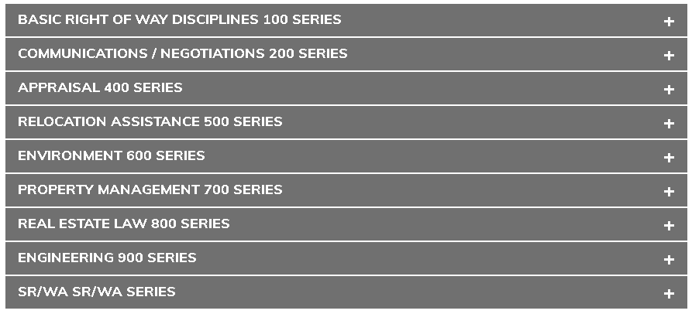

Slide 7
Locate a facility

Slide 8
Locating an Instructor

Slide 9
Select an Instructor

Slide 10
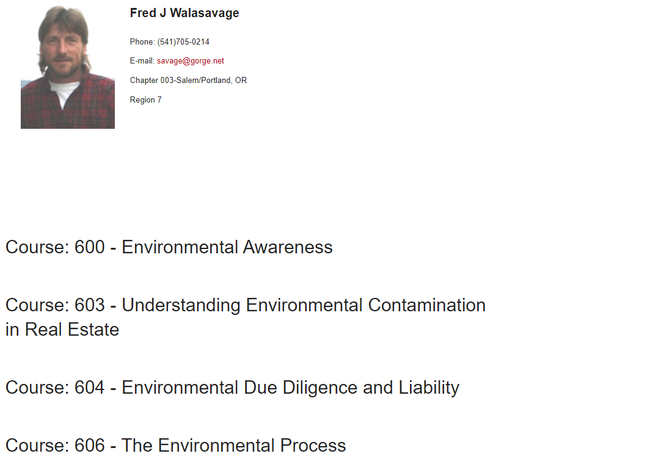
Select an Instructor

Slide 11
Hiring Letter

Slide 12
Submit this EARLY!!!
Course Sponsorship/Marketing Agreement (CSMA)
Submit
this
EARLY!!!

Slide 13
Advertise!!!

Slide 14
Select a Class Coordinator

Slide 15
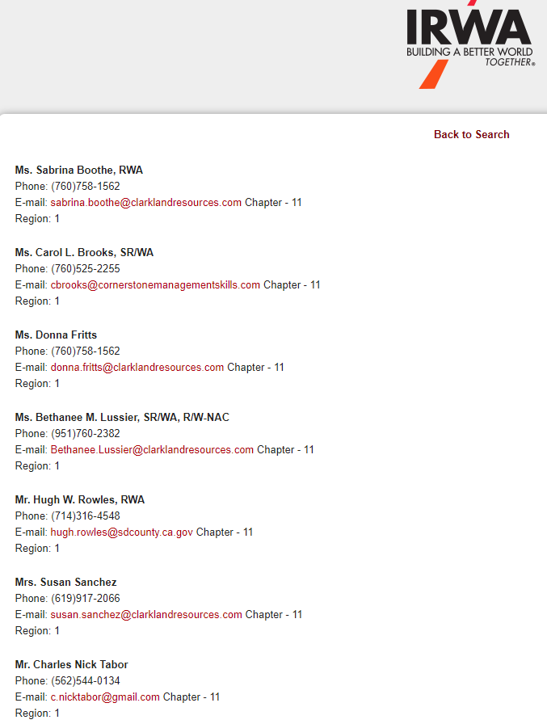
Select a Certified Course Coordinator

Slide 16
Book Order
Check Electronic Class Roster
Email Nathan Cruzado at HQ 30 days in advance
cruzado@irwaonline.org
310-538-0233 x124
OK to order extras sets of books

Slide 17
Invoice Review

Slide 18
Invoice Review

Slide 19
Recap…
Make the Decision to Host a Class!!!
1
Select a class
2
Facility
Instructor
Submit CSMA
3
Advertise!!!
Book Order
Invoice Review
4
Repeat!!!
5

Slide 20
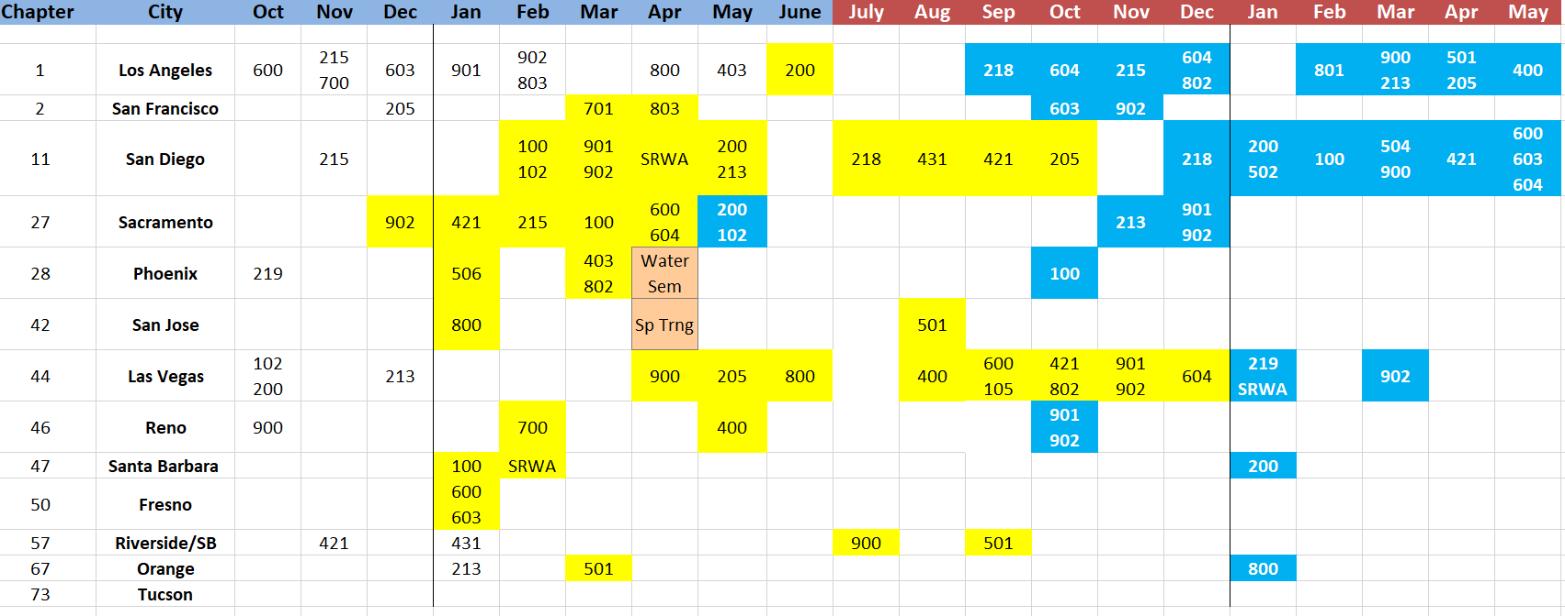
Region 1 Course Offerings
Insert Excel Spreadsheet….

