Slide 1

The IRWA, Chapter xx & You!
Luncheon Presentation

Slide 2
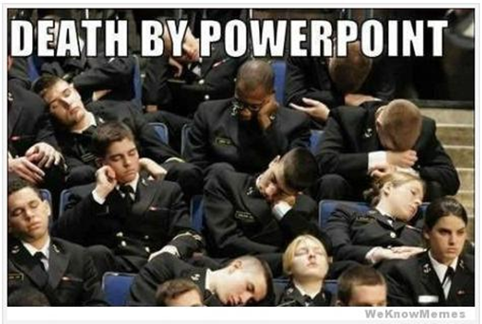

Our Purpose
We improve people's quality of life through infrastructure development.
Our Mission
We empower professionals by elevating ethics, learning and a standard of excellence within the global infrastructure real estate community.
Play Video
https://youtu.be/BlmOOYY_LBs

Slide 3
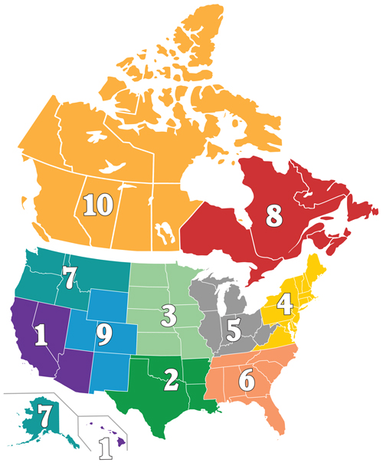
IRWA includes Chapters in Canada, U.S., South Africa, Nigeria, Mexico, Australia and Saudi Arabia.
The U.S. and Canadian Chapters are divided in to 10
Regions.
Chapter x is part of Region x.
Our Region is represented by a Chair and Vice Chair:
xxxxxxx

Slide 4
IRWA Structure
International Executive Committee (IEC)
Who & what do they do…
Aimie L. Mims, SR/WA, R/W-AMC, R/W-NAC– President
Sharon N. Slauenwhite, SR/WA – President-Elect
Jacob D. Farrell, SR/WA– Vice President
James A. Olschewski, SR/WA, R/W-NAC– Treasurer
Judy Jones, SR/WA, R/W-AC, R/W-NAC– Secretary
Elected by you International Delegates at Annual Conference
Bradford Kuhn, Esq. – General Counsel
Daniel Stekol– Interim CEO
International Governing Council (IGC)
IEC members plus our Region Chairs
Who & what do they do…

Slide 5




IRWA Structure
Elect
Chapter Members
International Directors
Nominate
Elect
Region Chairs
International Executive Committee (IEC)

Slide 6
IRWA Structure
Committees and Communities of Practice Who & what do they do…
International Service Committees Ethics Nominations & Elections The Partnership for Infrastructure Professional Education Credentialing Committee Finance | International Industry Committees Electric & Utilities International Public Agencies Oil & Gas Pipelines Transportation | International Discipline Communities of Practice Asset Management Environment Relocation Survey & Engineering Valuation | International Working Groups International Relations Young Professionals
How do I get involved?

Slide 7
What is the RWIEF????
Right of Way International Education Foundation
It all started in 1972, with the publishing of the seminal text, “The Principles of Right of Way.”
Primary purpose to fund right of way education initiatives.
Continuing education and professional development are essential to the growth and advancement of the ROW profession.
Over $1.2 million in assets.
Non-profit tax exempt corporation.
Funding has been allocated to projects that fall within these categories:
  New Course development
  Revamping of existing courses
  Web-based training programs
  Educational summits
  Career development and outreach
Most recently, your Chapter xx donated $xx to RWIEF at the Annual Education Conference.

Slide 8
Scholarship Program Information
Funded by the RWIEF, xxxxxx new announcement coming soon similar to 40 for 40….
RWIEF Region Professional of the Year Scholarship - $500
To encourage and provide incentives for region professionals to further their education by taking IRWA courses and/or attending the annual education conference.
Each region has its own selection process
SARPA Scholarship Sponsored by the RWIEF
awarded to active students (IRWA members or their family) majoring in a course of study related to the right of way or public works administration profession.
Recipients are chosen every year by the International Nominations and Elections Committee.

Slide 9

Our Chapter xx Executive Board Leadership
President/International Director –
Vice President/International Director –
Treasurer –
Secretary –
Past President –
This could be you………………………..

Slide 10
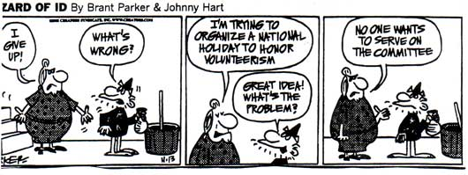
Chapter xx Current Committees
We are a Chapter dependent on our committed band of volunteers!
Volunteers needed….new openings are listed in (insert Newsletter name ) each month
xxx
xxx
xxx

Slide 11
Chapter xx – Committees
Check out the monthly newsletter, xxxxx, it lists who’s who and how to contact them.
Some of the volunteers you probably have the most contact with:
Membership - Jann Edmunds - Contra Costa County at Jann.edmunds@pw.cccounty.us
Newsletter Editor - Ellen Niemann at ellen.niemann52@gmail.com
Nominations & Elections - Eric Roman, SR/WA, R/W-AC from AR/WS at eroman@arws.com
Professional Development - Steve Castellano, SR/WA, R/W-NAC from AR/WS at scastellano@arws.com
& Tara Peterson, SR/WA at tandlpeterson@comcast.net
Education - Lisa Robertson, SR/WA, RW-NAC from PG&E at LMHR@pge.com

Slide 12
How does our Chapter make money?
Memberships – we received $20 from IRWA Headquarters for each new member or renewing member.
Classroom courses – Chapter pays for Instructor’s fee & travel expenses, venue and food costs.
Chapter Incentive Program (ChIP)
  Membership growth year over year of at least 5%
  $10 per participant in classroom courses
  $75 per quarter for completing administrative uploads of Chapter data to IRWA HQ
Luncheons – Let’s talk about this….
We provide a head-count to the restaurant or venue prior to the event date and commit to paying for the anticipated number of guests. If a member signs up to attend but doesn’t pay for the lunch we lose that money.

Slide 13

Updates on Professional Development
Xxx and xxx
Chapter xx Professional Development Committee Co-Chairs
Add info……

Slide 14
Updates on Professional Development
xxxxxx

Slide 15
Professional Designations
IRWA offers two career paths for Right of Way Professionals: A generalist path and a specialist path. Certifications can be achieved as either a generalist or as specialist.
Industry Path – Earn the RWA, RWP and SR/WA designations
Oil & Gas
Electric & Utility
Transportation
Industry Generalist
Specialist Certifications
R/W-AC Appraisal Certification
R/W-AMC Asset/Property Management Certification
R/W-NAC Negotiation and Acquisition Certification
R/W-RAC Relocation Assistance Certification Plus:
R/W-URAC Uniform Act Certification
R/W-EC Environmental Certification
IRWA's premier designation, the SR/WA Senior Right of Way Professional, is the highest achievement for the right of way professional.

Slide 16
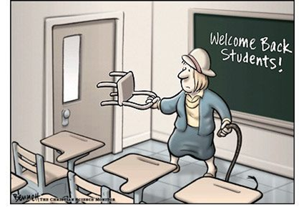
Chapter hosted IRWA Classroom Courses
Our Education Chair – xxxxxx
Is there a class you’d like to take? Let us know!
Do you have a venue to host classes?
Steps to hold a class here in Chapter xx
Working with the Education Chair:
Select course and check to see that it isn’t already being offered nearby
Go to “Class Scheduling Resources” at www.irwaonline.org to see the CLIMB certified instructors for that course, Lisa will contact instructors
Identify a venue and dates for the class
Identify your Course Coordinator – this could be you
Education Chair will help you with the Course Sponsorship Marketing Agreement (CSMA)
CSMA approved by IRWA HQ, we can begin marketing the class

Slide 17
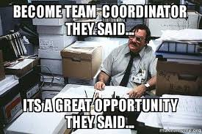
Being a course coordinator
Step 1 – Get Certified as a Course Coordinator!
IRWA Course Coordinator Certification Training Program is designed to provide you with information regarding your responsibilities before, during and after a class presentation.
Found through the IRWA University – link through “Education” on the IRWA website.
Step 2 – Work with Chapter Leadership to get a class scheduled
CSMA approved – sign and submit your Course Coordinator Agreement to HQ
Create marketing materials, follow up on marketing efforts… get it on our website and in the newsletter.
Chapter President will send out emails to members about the class.
Respond to questions about the class and logistics, hotel, transportation, etc.
Order materials based on projected attendance.
Day of the class: Bring materials, room set-up, coordinate with the instructor on day’s schedule and venue, bring snacks, complete roster and sign-in sheets, distribute course materials and evaluation sheets…

Slide 18


The Leadership Institute
The goal of the Leadership Institute is to establish a pipeline of qualified leaders at the international, regional and chapter levels, while delivering personal and professional value to each of our members as they build and advance in their careers.
FREE Online courses (for IRWA members) approved for up to 16 continuing education credits for IRWA recertification only.
Found through the IRWA University – link through “Education” on the IRWA website.
Examples:
Leaders Make Change Work
Motivating Volunteers
Make Meeting Work
Delegation and Empowerment

Slide 19
Upcoming events
Chapter Lunches
Classes
Region Forum
IRWA International Education Conference will be held in xxxxx
CE credit of 1 hour can now be provided to members for our luncheons that include an educational component.

Slide 20
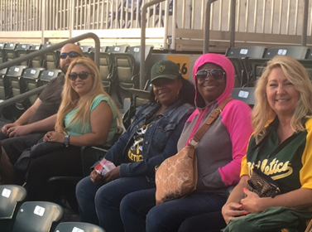
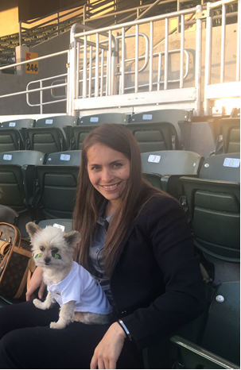
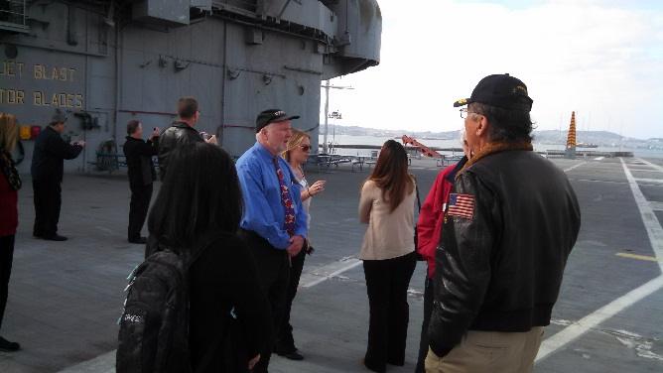
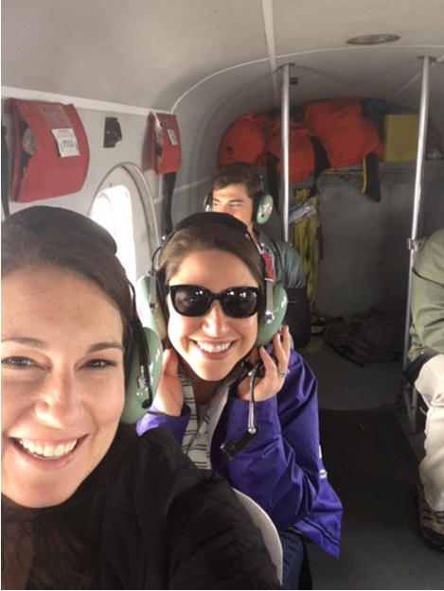
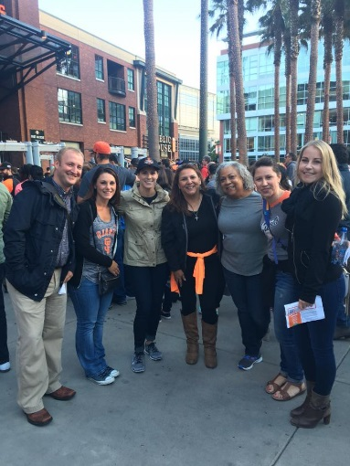
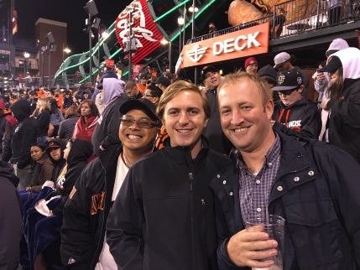
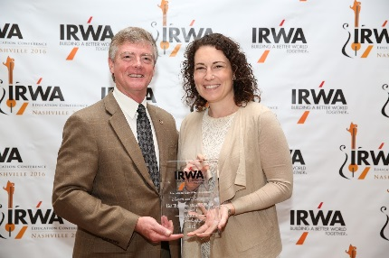
Thank you for being a valued Member of IRWA San Francisco Bay Area, Chapter x!

